Slide 1
ADO.NET - Lesson 04
Reading Data with the SqlDataReader
Training time: 10 minutes
Author: CuongNV3

Slide 2
Objectives
Learn what a SqlDataReader is used for.
Know how to read data using a SqlDataReader.
Understand the need to close a SqlDataReader.

Slide 3
Introduction
A SqlDataReader is a type that is good for reading data in the most efficient manner possible. You can *not* use it for writing data. SqlDataReaders are often described as fast-forward firehose-like streams of data..
You can read from SqlDataReader objects in a forward-only sequential manner. Once you've read some data, you must save it because you will not be able to go back and read it again.
The forward only design of the SqlDataReader is what enables it to be fast. It doesn't have overhead associated with traversing the data or writing it back to the data source. Therefore, if your only requirement for a group of data is for reading one time and you want the fastest method possible, the SqlDataReader is the best choice. Also, if the amount of data you need to read is larger than what you would prefer to hold in memory beyond a single call, then the streaming behavior of the SqlDataReader would be a good choice.

Slide 4
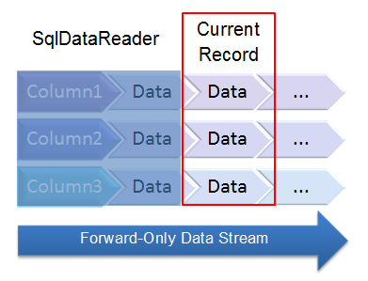
Introduction (2)

Slide 5

Creating a SqlDataReader Object
Getting an instance of a SqlDataReader is a little different than the way you instantiate other ADO.NET objects.
You must call ExecuteReader on a command object, like this:

Slide 6
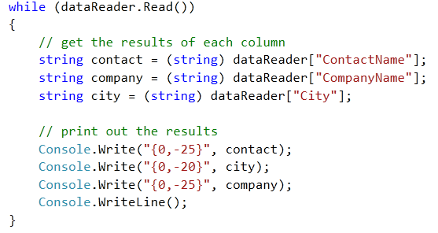
Reading Data
The SqlDataReader returns data via a sequential stream. To read this data, you must pull data from a table row-by-row. Once a row has been read, the previous row is no longer available. The typical method of reading from the data stream returned by the SqlDataReader is to iterate through each row with a while loop.
The following code shows how to accomplish this:

Slide 7
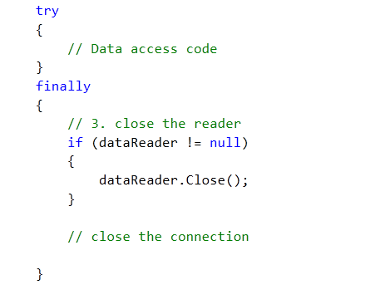
Finishing Up
Always remember to close your SqlDataReader, just like you need to close the SqlConnection.
Wrap the data access code in a try block and put the close operation in the finally block, like this:

Slide 8
Using SqlDataReader
Querying Data
Demo

Slide 9
Summary
SqlDataReader objects allow you to read data in a fast forward-only manner.
You obtain data by reading each row from the data stream.
Call the Close method of the SqlDataReader to ensure there are not any resource leaks.

Slide 10
Q&A
Thanks!

